Slide 1
Music Store Data Analysis & Business Insights using SQL
Presented by: Monalika Ghosh For Internship at: Inlighn Tech

Slide 2
Objective
The main objective of this project is to analyze the music store’s data to extract valuable insights related to business performance, customer behavior, and music trends. The analysis focuses on identifying top revenue-generating locations, most loyal customers, popular genres, and key patterns in sales. These insights aim to support strategic decisions such as event planning, customer targeting, and product promotion.
Aim:
- Understand the store’s revenue streams and customer segmentation.
- Identify high-performing cities and countries to plan promotional events.
- Determine popular music genres and top-performing artists for inventory optimization.
- Recognize loyal customers and high-value segments to enhance personalized marketing
strategies.
Expected Outcomes:
- Insights into the best city for promotional events.
- Identification of top-spending and loyal customers.
- Popular music genres by country.
- Artists generating the highest revenue.
- Sales patterns and peak revenue days.

Slide 3
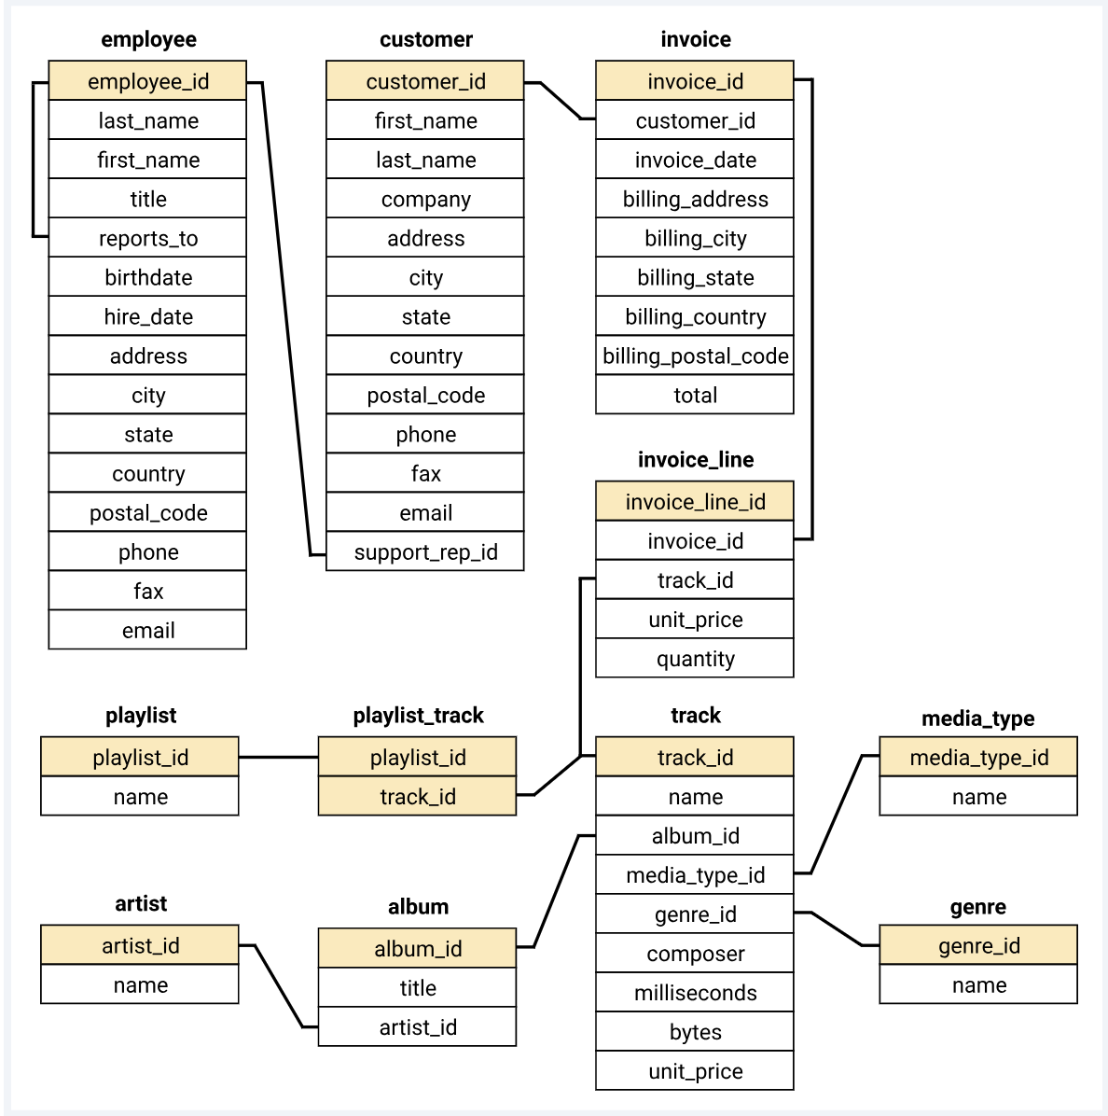

Slide 4
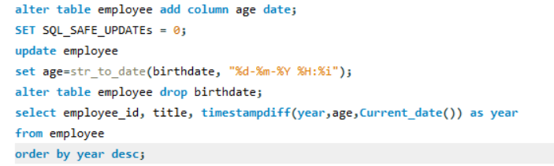
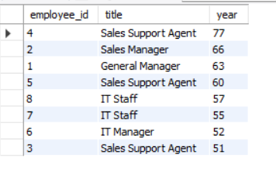
1: Find the most senior employee based on job title.

Slide 5
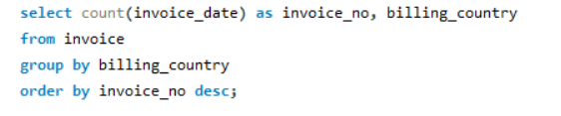
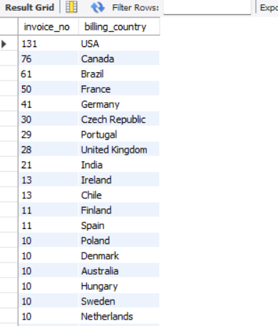
2: Determine which countries have the most invoices.

Slide 6
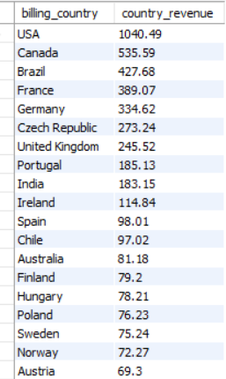
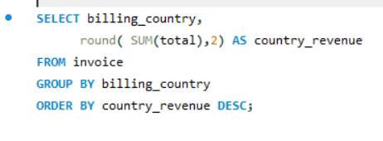
3.Which country brings the most revenue?

Slide 7

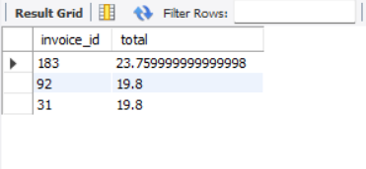
4. Identify the top 3 invoice totals.

Slide 8
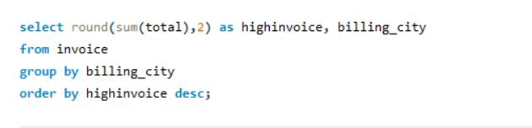
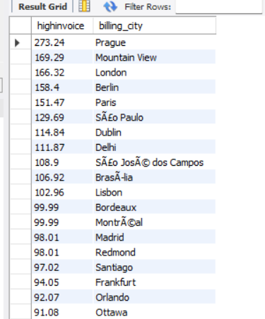
5. Find the city with the highest total invoice amount to determine the best location for a promotional event.

Slide 9
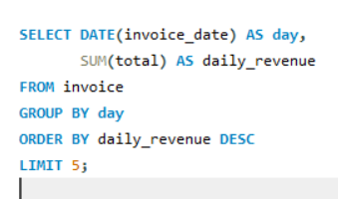
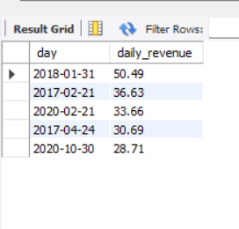
6. Peak Revenue Days (Top 5 days with the highest revenue)

Slide 10
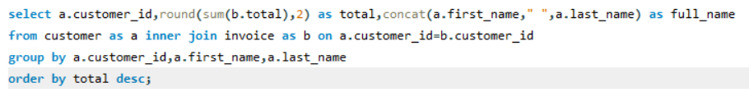
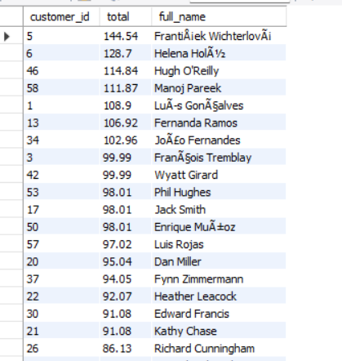
7. Identify the customer who has spent the most money.

Slide 11
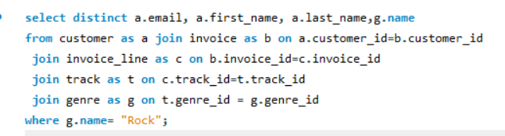
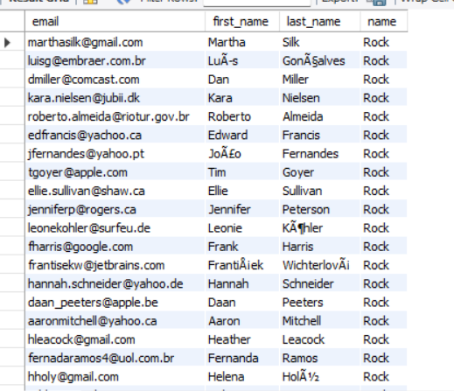
8. Find the email, first name, and last name of customers who listen to Rock music.

Slide 12
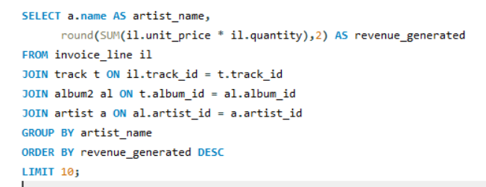
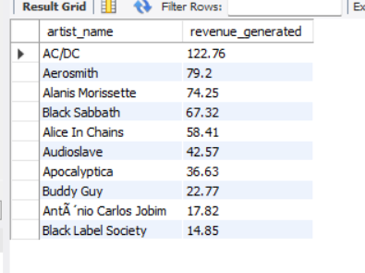
9. Which Artists Generate the Most Revenue?

Slide 13
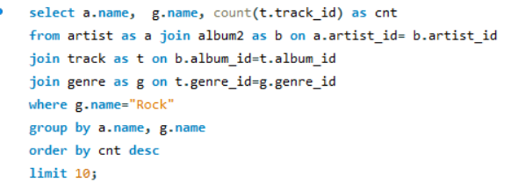
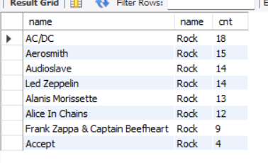
10. Identify the top 10 rock artists based on track count.

Slide 14
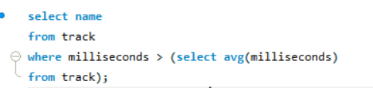
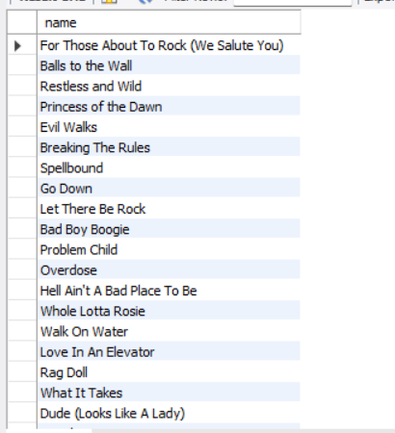
11. Find all track names that are longer than the average track length.

Slide 15
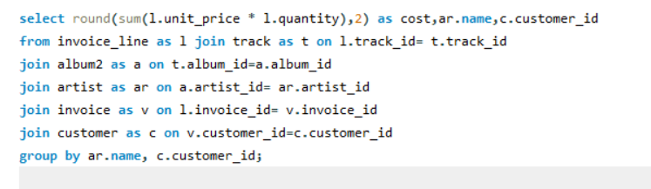
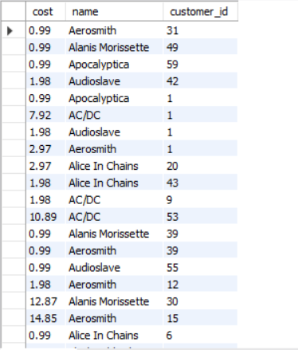
12. Calculate how much each customer has spent on each artist.

Slide 16
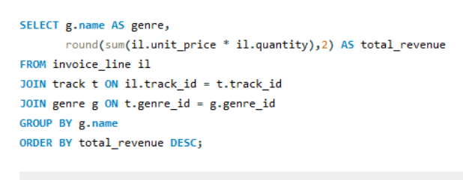
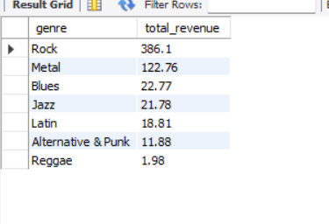
13.Which are the best-Selling Genres by Revenue

Slide 17
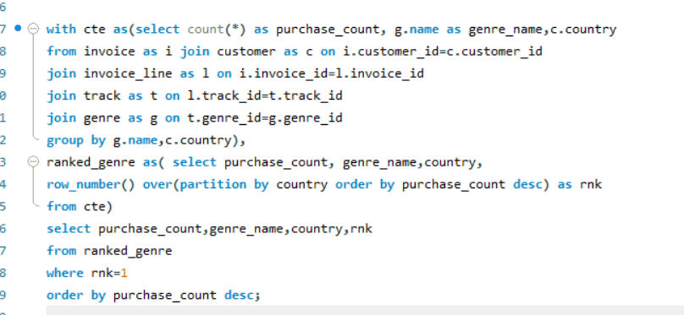
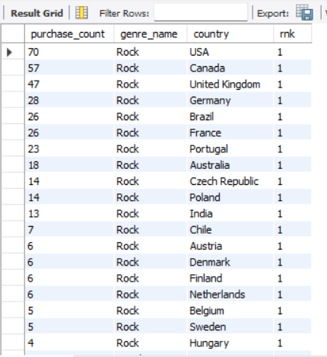
14. Determine the most popular music genre for each country based on purchases.

Slide 18
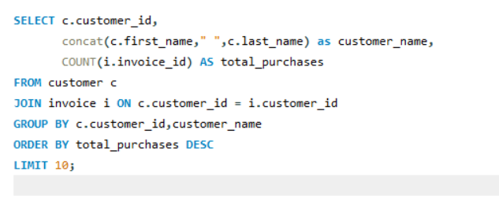
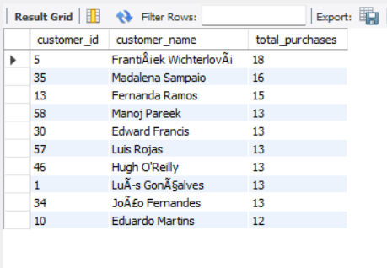
15. Most Loyal Customers by Total Number of Purchases

Slide 19
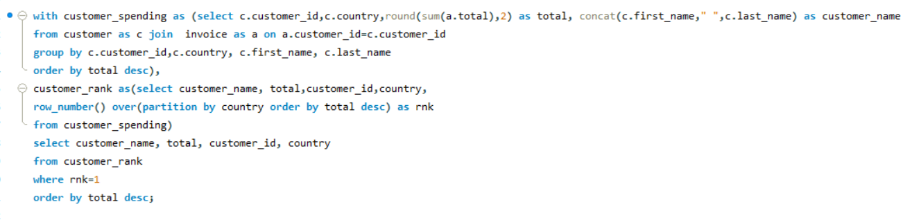
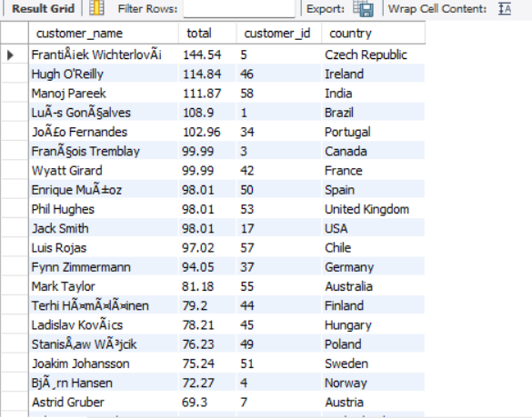
16. Identify the top-spending customer for each country.

Slide 20
Key Insights
Top Countries: USA, Canada, Brazil → Focus for campaigns & inventory.
Highest Revenue Country: USA ($1040.49) → Launch major promotions here.
Best Cities for Events: Prague, Mountain View, London → Plan promo events.
Peak Revenue Days: Jan 31, Feb 21 → Schedule offers around these dates.
Top Customers: ID 5 ($144.54), ID 6 ($128.70) → Reward loyalty.
Top Genres: Rock ($386.1), Metal ($122.7) → Stock & promote these.
Popular Genre: Rock in USA, Canada, UK, Germany → Genre-based campaigns.
Top Artists: AC/DC, Aerosmith → Use for promotions.
Recommendations
Target USA, Canada, Brazil for marketing.
Organize events in Prague, Mountain View, London.
Boost Rock & Metal inventory.
Launch loyalty programs for top spenders.
Run discounts on peak revenue dates.
Personalize marketing using customer & genre insights.

Slide 21
THANK YOU!

